Slide 1
Bank Loan of Customers Analysis
Group members:

Slide 2
Introduction
This project focuses on analyzing the bank's loan finance dataset to provide insights using tools like Excel, SQL, Power BI, and Tableau. Key areas of investigation include year-wise loan amounts, revolving balances by grade and sub-grade, payment behavior based on verification status, state and month-wise loan status, and the impact of home ownership on last payment dates.
The project involves cleaning, manipulating, and analyzing data to gain insights. It also includes creating visualizations, reports, and dashboards to share findings with stakeholders. Statistical analysis, data modeling, and interpretation techniques may be used to reveal meaningful insights and trends.
This project aims to provide the bank with actionable insights to optimize its loan management practices, reduce risks, and improve overall customer satisfaction.

Slide 3
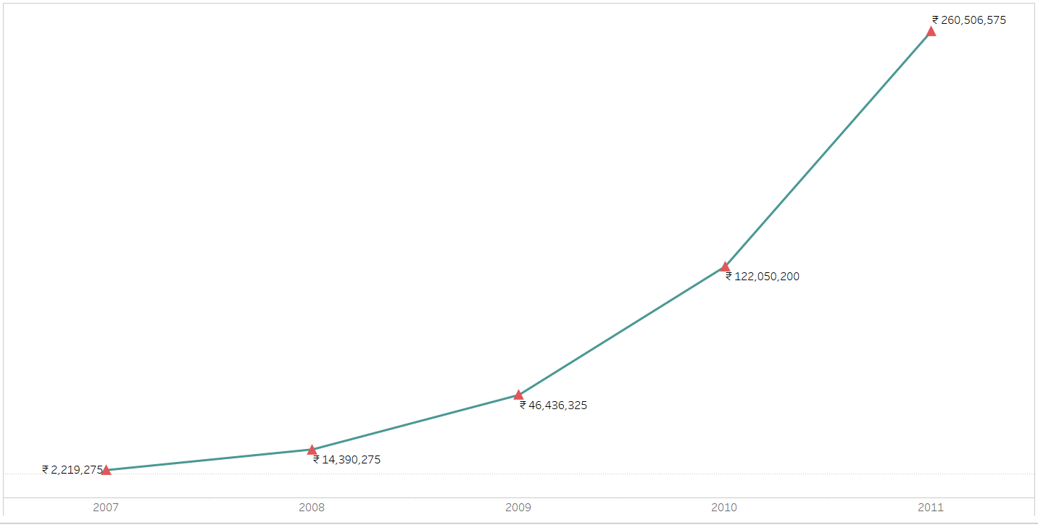
Year wise Loan Amount:
Observation:
Over the five year period, there is clear upward trend in loan amounts. The values steadily increase each year, indicating a consistent growth in lending activities.
Suggestion:
Conduct a detailed analysis of the loans issued in each year. It will helps to understand the reasons behind such increases.
Regularly review and adjust strategies to ensure they align with the changing economic and market trends.
Implement risk management strategies to ensure the institution is well-prepared for any unexpected challenges.
Conclusion:
The progressive increase in loan amounts from 2007 to 2011 signals a consistent growth pattern, indicating a rising demand for loans over the years. While this signifies positive economic activity, it's important to balance this growth with effective risk management. By understanding customer dynamics and closely monitoring trends, the institution can make informed decisions to sustain this positive trajectory in the future.

Slide 4
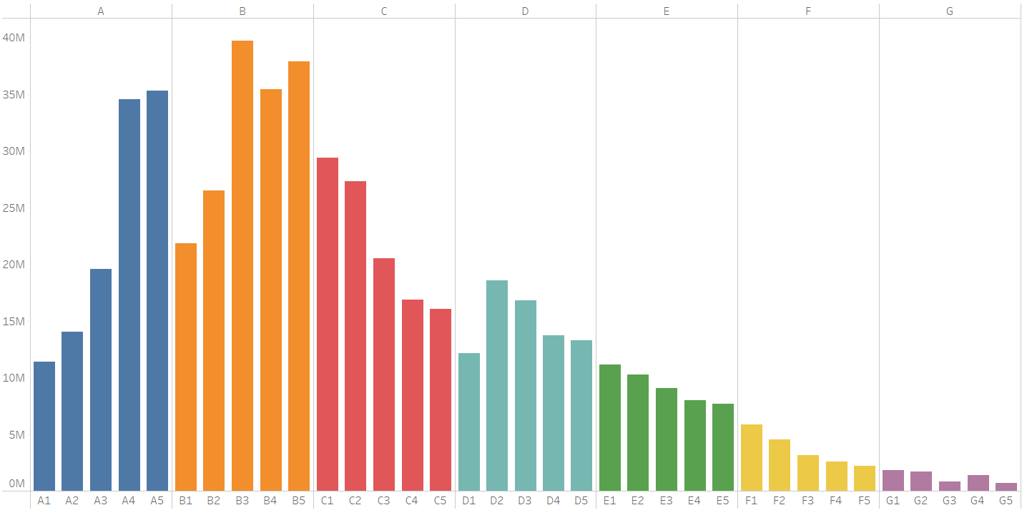
Grade and Sub-Grade wise revolving balance :
Observation:
Analyzing the Grade and sub-Grade wise revolving balance chart, we notice the following trends:
1. The revolving balance is high for Grade A , Grade B, and Grade C as compared to other grades. 2. Within each Grade, there is variability in the revolving balances across sub-Grades. Some sub-Grades exhibit higher balances compared to others within the same Grade.
Suggestion:
Conduct a comprehensive risk assessment for each Grade and sub-Grade. Understand the factors influencing the variations in revolving balances and implement targeted risk management strategies accordingly.
Conclusion:
The Grade and sub-Grade wise revolving balance chart provides insights into the distribution of balances across different risk categories. By understanding the patterns within each Grade, the institution can make informed decisions on risk management strategies and product development to better serve customers and optimize financial outcomes.

Slide 5
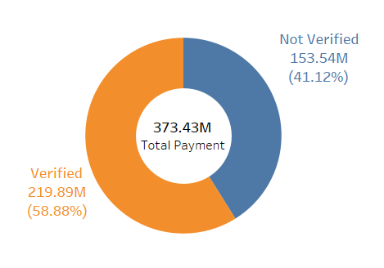
Total payment for Verified status VS Non-Verified Status :
Observation:
Looking at the data for bank loan payments, here's a simple observation:
•Verified Status: Customers with a verified status have made total payments of 219.89 million.
•Non-Verified Status: Customers without verification have made total payments of 153.54 million.
Suggestion:
Encourage customers to complete the verification process by making it easy and offering benefits. Increasing the number of verified customers may lead to higher total payments and strengthen the overall financial health of the bank.
Conclusion:
The data suggests that customers with verified status tend to make higher total payments on their bank loans. To leverage this trend, promoting and simplifying the verification process, along with communicating the associated benefits, can enhance overall customer engagement and financial performance for the bank.

Slide 6
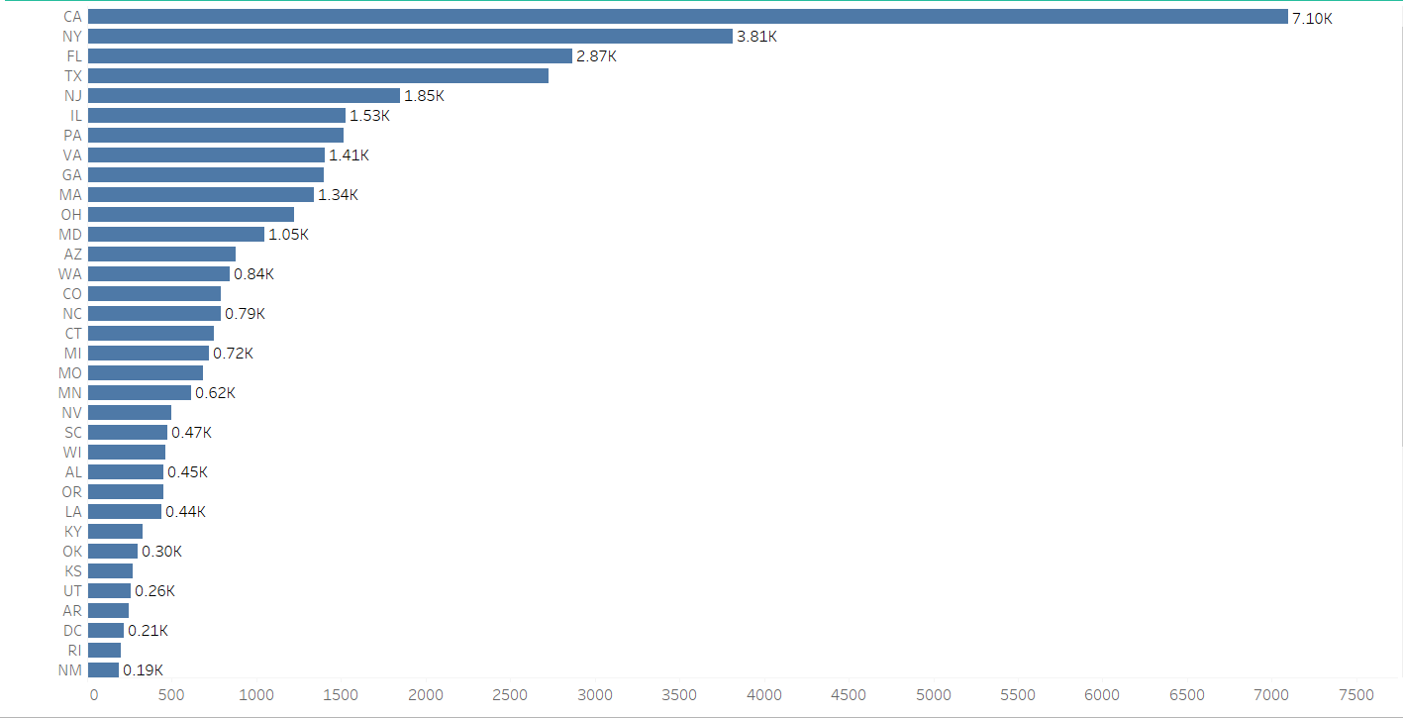
State wise loan status:
Observation:
Analyzing the State wise loan status chart, we notice the following trend:
•California leads with 7.10K loans, followed by New York and Florida, indicating high demand for loans in these states.
•While other states are having low loan numbers, which suggests lower demand or potential challenges.
Suggestion:
•Allocate more resources and marketing efforts in states like California, New York, and Florida where loan demand is high.
•Concentrate marketing efforts in states with lower loan numbers to identify opportunities for growth in these markets.
Conclusion:
The state-wise loan status chart indicates that certain states like California, New York, and Florida have high loan activity, while other states show lower numbers. Customizing strategies for each state can optimize performance and better results to regional needs.

Slide 7
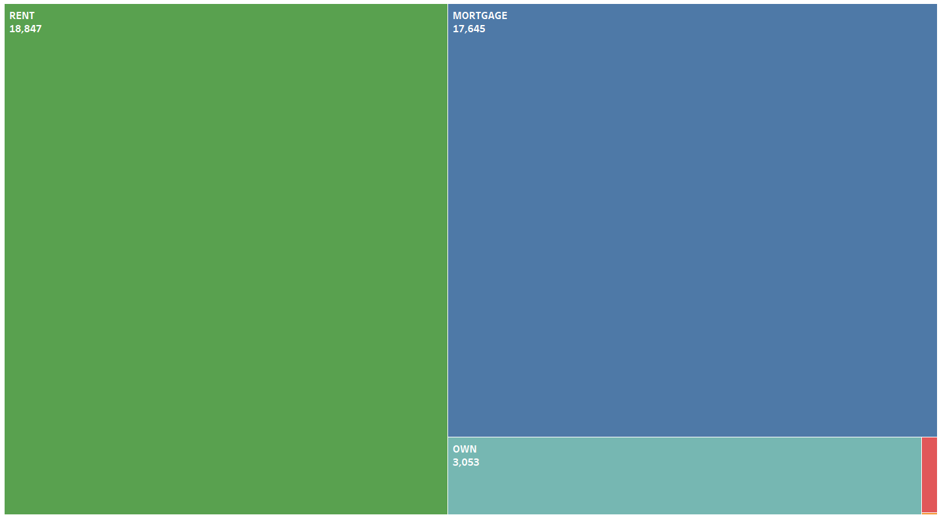
Home Ownership VS Last Payment date:
Observation:
Looking at the data for bank loan last payment date, here's a simple observation:
Renters have the highest number of last payments, followed by mortgage holders and individuals who fully own their homes.
Suggestion:
1. Recognizing the high number of renters and mortgage, the bank could offer targeted support or resources to assist this group in managing their finances and loan obligations effectively.
2. For individuals who own their homes outright, the bank could introduce services or products that acknowledge their specific financial circumstances.
Conclusion:
The following chart indicates that renters are the largest group making last payments on their bank loans, followed closely by mortgage holders. The bank can enhance its services by understanding and addressing the distinct needs of these groups, offering support to both renters and homeowners, and providing resources to facilitate successful loan repayments.

Slide 8
Conclusion:
Through the combined use of Excel, SQL, Power BI, and Tableau, this project has provided a comprehensive understanding of the data.
This integrated analysis equips the bank with a clearer understanding of its loan dynamics, enabling strategic adjustments to optimize loan management, minimize risks, and improve overall customer satisfaction.
Overall reports not only facilitated a more profound comprehension of the data but has also provided actionable insights for informed decision-making.

Slide 9
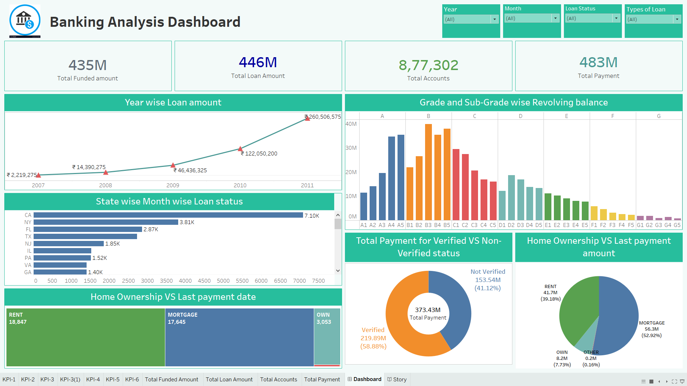
Dashboard in Tableau

Slide 10
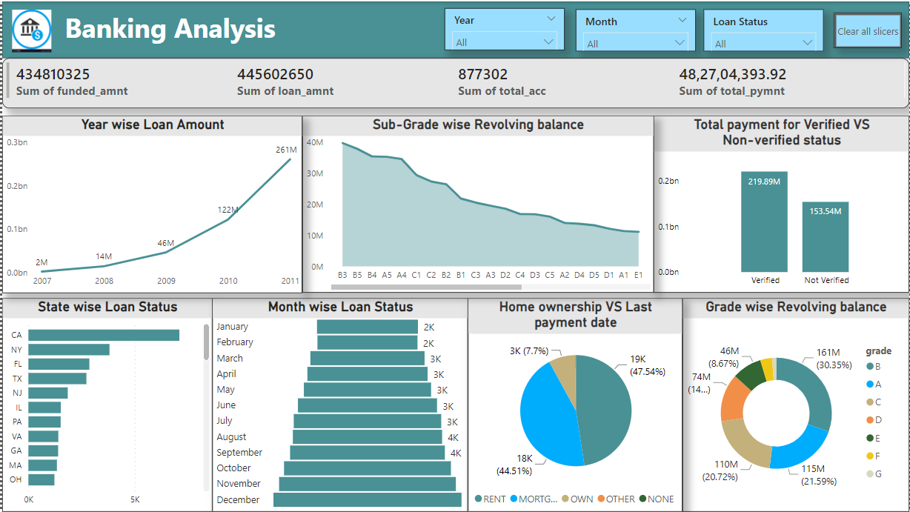
Dashboard in Power BI

Slide 11
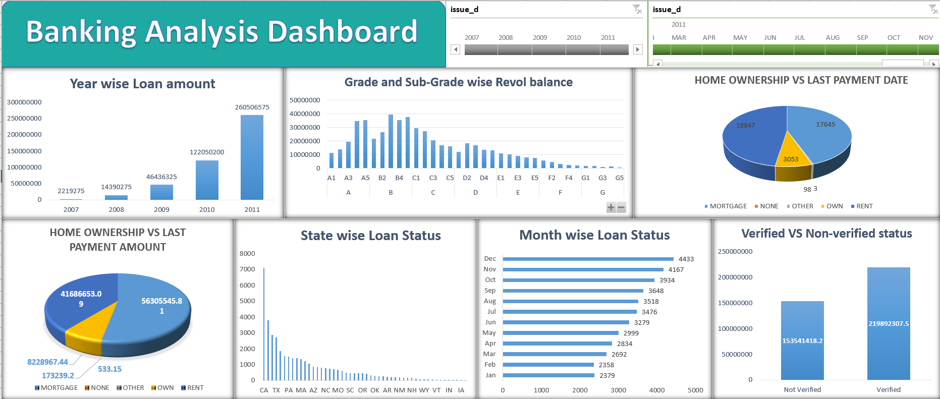
Dashboard in Excel

Slide 12
THANK YOU

